Slide 1



Excavation & Trenching
Presented by
Name
Title
Date

Slide 2
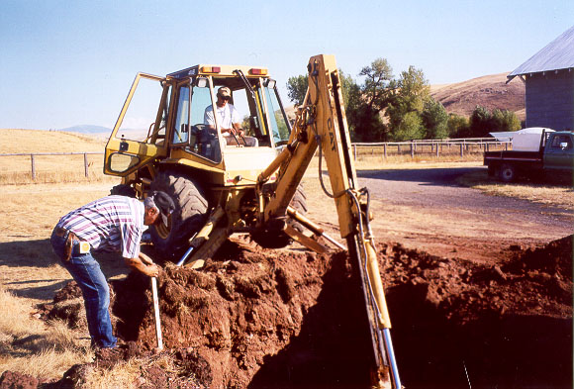
Excavations and Trenches

Slide 3

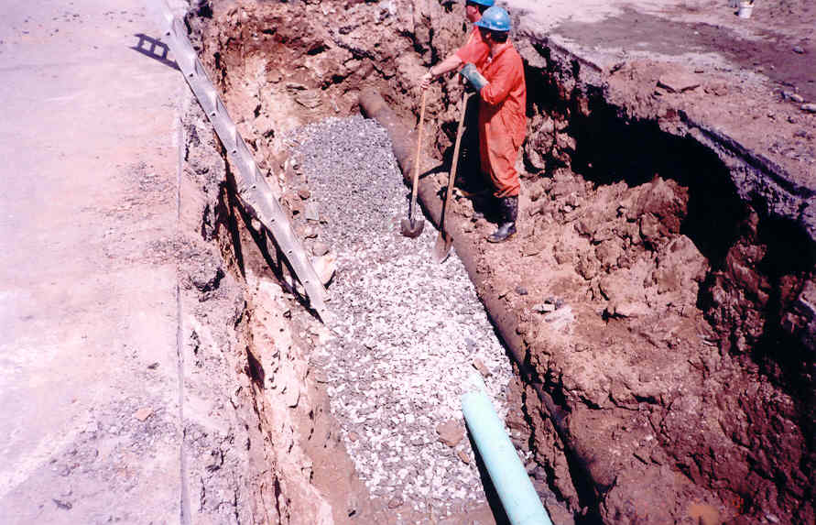
Excavations and Trenches
Presentation Outline
Introduction
Presentation
Summary

Slide 4
Excavations and Trenches
Introduction
  Presentation Objectives
  Acts and Regulations overseen by WorkSafeNB

Slide 5
Excavations and Trenches
Presentation Content
  OHS Act and Regulation Requirements
  Trenching Inspection and Protection
  Underground Utilities

Slide 6
Excavations and Trenches
Summary
  OHS Regulation Overview
  Questions and Discussions
  Points to ponder

Slide 7
Introduction
Objectives
Participants should be able to identity:
  Employer and employee obligations under the OHS Act and regulations
  Regulation minimum requirements for working in excavations and trenches
  Safe methods for working in and around trenches

Slide 8

Introduction
Acts and Regulations
Ch W-13 Workers’ Compensation Act
  (6 Regulations)
Ch O-0.2 Occupational Health & Safety Act (7 Regulations)
Ch W-14 WHSCC Act

Slide 9
Introduction
Acts and Regulations
Ch W-13 Workers’ Compensation Act
  Duties to report accidents (Form 67)
  Assessment rates and experience rating

Slide 10
Introduction
Acts and Regulations
Ch O-0.2 Occupational Health & Safety Act
  Duties of employers and employees
  Employees 3 basic rights
    Right to know
    Right to participate
    Right to refuse

Slide 11
Introduction
Acts and Regulations
Ch W-14 Workplace Health, Safety and Compensation Commission Act allows WorkSafeNB to oversee the implementation and application of all three acts and their regulations

Slide 12
Occupational Health & Safety Act
Ch O-0.2
“Employee" means
  a person employed at or in a place of employment, or
  a person at or in a place of employment for any purpose in connection therewith,

Slide 13
Occupational Health& Safety Act
Ch O-0.2
“Employer" means
  A person who employs one or more employees,
  A manager, superintendent, supervisor, overseer or any person having authority over an employee at a place of employment,
  An agent of the above two

Slide 14

Occupational Health & Safety Act
Ch O-0.2
Every employer shall (Section 9)
take every reasonable precaution to ensure the health and safety of his employees;
comply with this Act, the regulations…
ensure that his employees comply with this Act, the regulations…

Slide 15
Occupational Health & Safety Act
Ch O-0.2
Every employer shall (Section 9)
Ensure that…equipment, machines, devices and materials are maintained in good condition and are of minimum risk to health and safety…
acquaint an employee with any hazard to be found…
provide such information, instruction, training and supervision as are necessary to ensure an employee's health and safety

Slide 16
Occupational Health & Safety Act
Ch O-0.2
Every employer shall…
provide and maintain in good condition such protective equipment as is required by regulation and ensure that such equipment is used by an employee

Slide 17
Occupational Health & Safety Act
Ch O-0.2
Every employer shall…
co-operate with a committee…, a health and safety representative,…and with any person responsible for the enforcement of this Act and the regulations

Slide 18
Occupational Health & Safety Act
Ch O-0.2
Every employee shall…
comply with this Act, the regulations…
conduct himself to ensure his own health and safety and that of other persons…
report to the employer the existence of any hazard of which he is aware;

Slide 19
Occupational Health & Safety Act
Ch O-0.2
Every employee shall…
wear or use such protective equipment as is required by regulation;
consult and co-operate with the committee where one has been established or with the health and safety representative…
co-operate with any person responsible for the enforcement of this Act and the regulations.

Slide 20

Occupational Health & Safety Act
Ch O-0.2
General Regulation 91-191
under the
Occupational Health and Safety Act

Slide 21
General Regulation 91-191 under the Occupational Health and Safety Act
PART I - INTERPRETATION
2 In this Regulation "competent" means
(a) qualified, because of such factors as knowledge, training and experience, to do assigned work in a manner that will ensure the health and safety of persons,

Slide 22
General Regulation 91-191 under the Occupational Health and Safety Act
PART I - INTERPRETATION
2 In this Regulation "competent" means
(b) knowledgeable about the provisions of the Act and the regulations that apply to the assigned work, and

Slide 23
General Regulation 91-191 under the Occupational Health and Safety Act
PART I - INTERPRETATION
2 In this Regulation "competent" means
(c) knowledgeable about potential or actual danger to health or safety connected with the assigned work;

Slide 24
General Regulation 91-191 under the Occupational Health and Safety Act
PART XIII
EXCAVATIONS AND TRENCHES
Sections 180 to 188

Slide 25
General Regulation 91-191
PART XIII
EXCAVATIONS AND TRENCHES
Section 180(1)
Before beginning an excavation or trench, an employer shall ensure that the location of any underground utility line or piping is determined.

Slide 26
General Regulation 91-191
PART XIII
EXCAVATIONS AND TRENCHES
Section 180(2)
Where employees are working within 600 mm of
underground utility line or piping, an employer
shall ensure that
(a) the authority operating the utility line or piping has been notified of the operation,
(b) the utility line has been de-energized, and
(c) an adequate operating procedure is used by the employees.

Slide 27
General Regulation 91-191
PART XIII
EXCAVATIONS AND TRENCHES
Section 180(3)
An employer shall ensure that utility poles, posts and similar structures are supported or removed if they are within 3 m of an excavation or trench that is more than 1.2 m deep.

Slide 28
General Regulation 91-191
PART XIII
EXCAVATIONS AND TRENCHES
Section 181(1)
An employer shall ensure that the walls of an
excavation or trench are supported by shoring,
bracing or caging except when the excavation
or trench
(a) is less than 1.2 m deep,
(b) subject to subsection (2), is cut in solid rock,

Slide 29
General Regulation 91-191
PART XIII
EXCAVATIONS AND TRENCHES
Section 181(1) continued
…walls…are supported…except when the excavation or trench
(c) is sloped or benched to within 1.2 m of the bottom of the excavation or trench with the slope or bench not exceeding 1 m of vertical rise to each 1 m of horizontal run, or
(d) is one that an employee is not required to enter.

Slide 30
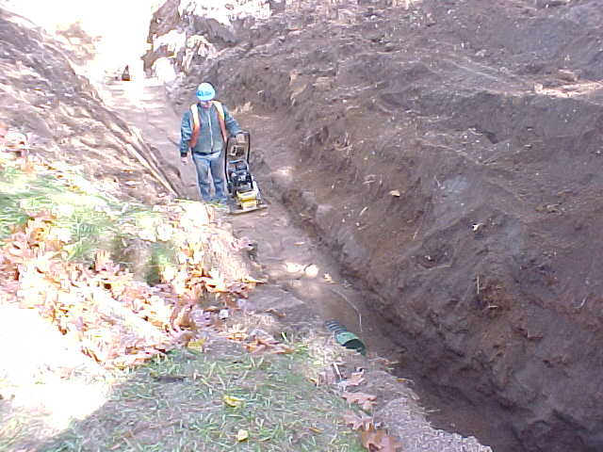
General Regulation 91-191
PART XIII
EXCAVATIONS AND TRENCHES
Section 181(1) c…sloped or benched…

Slide 31
General Regulation 91-191
PART XIII
EXCAVATIONS AND TRENCHES
Section 181(2)
Where the walls or crests of an excavation or
trench are cut in solid rock and are not stable, an
employer shall ensure that the walls and crests
are adequately supported by rock bolts, wire
mesh,shoring or a method that provides
equivalent support.

Slide 32
General Regulation 91-191
PART XIII
EXCAVATIONS AND TRENCHES
Section 181(3)
Where powered mobile equipment or a mobile crane is used near the edge of an excavation or trench, an employer shall ensure that any shoring, bracing or caging for the excavation or trench is adequate to support the increased pressure.

Slide 33
General Regulation 91-191
PART XIII
EXCAVATIONS AND TRENCHES
Section 181(4)
An employer shall ensure that shoring, bracing or caging for an excavation or trench is certified as adequate by an engineer and shall make the proof of the certification available to an officer on request.

Slide 34
General Regulation 91-191
PART XIII
EXCAVATIONS AND TRENCHES
Section 182(1)
An employer shall ensure that an employee does not,
and no employee shall, enter an excavation or trench
1.2 m or more in depth unless
(a) the walls of the excavation or trench are supported by shoring, bracing or caging, the excavation or trench is cut in solid rock or the excavation or trench is sloped or benched to within 1.2 m of the bottom of the excavation or trench with the slope not exceeding 1 m of vertical rise to each 1 m of horizontal run,

Slide 35
General Regulation 91-191
PART XIII
EXCAVATIONS AND TRENCHES
Section 182(1) continued
…and no employee shall, enter an excavation or
trench 1.2 m or more in depth unless
(b) subsections 181(2), (3) and (4) have been complied with,
(c) loose material that may fall into the excavation or trench has been removed, and

Slide 36
General Regulation 91-191
PART XIII
EXCAVATIONS AND TRENCHES
Section 182(1) continued
…and no employee shall, enter an excavation or trench
1.2 m or more in depth unless
(d) a ladder that extends at least 1 m above the excavation or trench is installed no more than 15 m from where the employee is working or some other safe means of access and egress is provided.

Slide 37
General Regulation 91-191
PART XIII
EXCAVATIONS AND TRENCHES
Section 182(2)
Notwithstanding subsection (1), an employee may
enter an excavation 1.2 m or more in depth to
install bracing if the employee remains a distance
from the face of the excavation equal to or greater
than the depth of the excavation.

Slide 38
General Regulation 91-191
PART XIII
EXCAVATIONS AND TRENCHES
Section 182(3)
Notwithstanding subsection (1), an employer shall
ensure that an employee does not, and no
employee shall, enter an excavation or trench
1.2m or more in depth to install or remove shoring
or caging from a position inside an excavation or a
trench.

Slide 39
General Regulation 91-191
PART XIII
EXCAVATIONS AND TRENCHES
Section 183(1)
Subject to subsection (2), an employer shall ensure
that excavated material is kept at least 1.2 m away
from the edge of an excavation or trench.

Slide 40
General Regulation 91-191
PART XIII
EXCAVATIONS AND TRENCHES
Section 183(2)
Where an excavation or trench is more than 1.8 m
deep in rock, an employer shall ensure that
(a) excavated material is located back from the face of the excavation or trench a distance equal to at least the height of the excavated material, or
(b) a fence that is adequate to support the excavated material is erected at a minimum distance of 1 m from the face of the excavation or trench.

Slide 41
General Regulation 91-191
PART XIII
EXCAVATIONS AND TRENCHES
Section 184(1)
An employer shall ensure that an excavation or
trench in which an employee works is kept
reasonably free of water.

Slide 42
General Regulation 91-191
PART XIII
EXCAVATIONS AND TRENCHES
Section 184(2)
Where an employee may be exposed to a
hazardous gas or to an oxygen deficient or oxygen
rich atmosphere in an excavation or trench, an
employer shall ensure that testing is carried out in
accordance with section 263 before the employee
enters the excavation or trench.

Slide 43
General Regulation 91-191
PART XIII
EXCAVATIONS AND TRENCHES
General Regulation 91-191
Part XVII, Confined Space
Sections 262 to 272

Slide 44
General Regulation 91-191
PART XIII
EXCAVATIONS AND TRENCHES
Section 184(3)
An employer shall ensure that no hazardous
substance is stored in an excavation or
trench.

Slide 45
General Regulation 91-191
PART XIII
EXCAVATIONS AND TRENCHES
Section 184(4)
An employer shall ensure that precautions are taken to prevent the accumulation of hazardous gases in an excavation or trench and that adequate ventilation is provided in the excavation or trench.

Slide 46
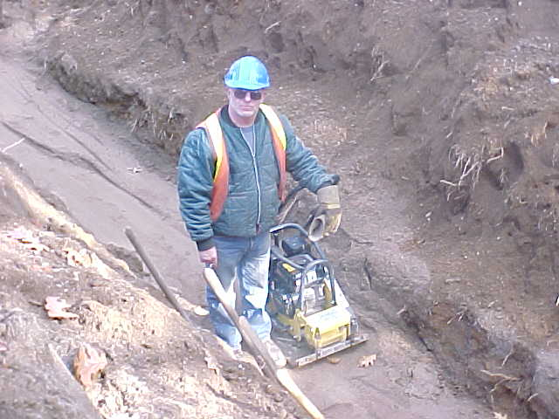
General Regulation 91-191
PART XIII
EXCAVATIONS AND TRENCHES
Section 184(4)
…prevent the accumulation of hazardous gases…

Slide 47
General Regulation 91-191
PART XIII
EXCAVATIONS AND TRENCHES
Section 185
Where an employee is working in an excavation or
trench, an employer shall ensure that there is an
employee working on the surface who is able to
observe the employee working in the excavation
or trench.

Slide 48
General Regulation 91-191
PART XIII
EXCAVATIONS AND TRENCHES
Section 186
An employer shall ensure that an operator of
powered mobile equipment or a mobile crane does
not lower material into an excavation or trench, and
no such operator shall lower material into an
excavation or trench, unless
(a) the operator has unrestricted visibility, or
(b) a signaller is used to direct the movement of the material.

Slide 49
General Regulation 91-191
PART XIII
EXCAVATIONS AND TRENCHES
Section 187
An employee shall not move under or stay under
any material being lowered into an excavation or
trench.

Slide 50
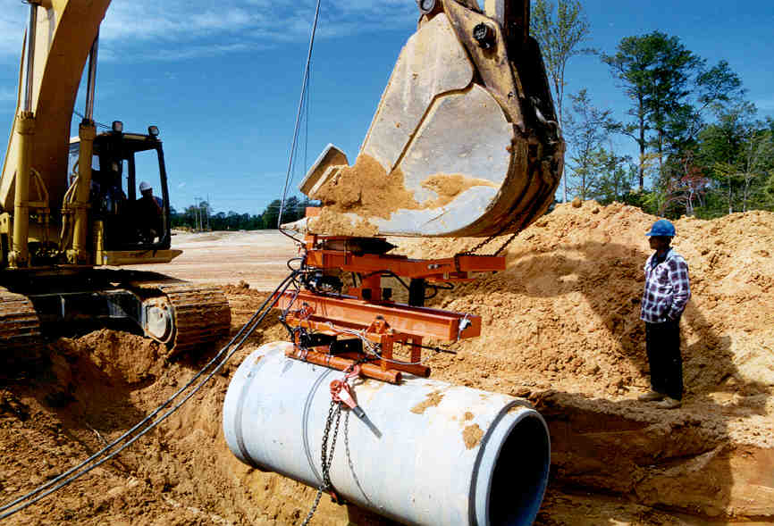
General Regulation 91-191
PART XIII
EXCAVATIONS AND TRENCHES
Section 187
…shall not…stay under any material being lowered…

Slide 51
General Regulation 91-191
PART XIII
EXCAVATIONS AND TRENCHES
Section 188(1)
An employer shall ensure that an excavation or
trench is adequately illuminated
(a) when work is being carried out in or near the excavation or trench, and
(b) by warning lights or reflective materials to prevent inadvertent entry.

Slide 52
General Regulation 91-191
PART XIII
EXCAVATIONS AND TRENCHES
Section 188(2)
An employer shall ensure that an adequate barrier
is set up around the excavation or trench so as to
protect employees working in the excavation or
trench from vehicular traffic.

Slide 53
General Regulation 91-191
PART X
CONSTRUCTION, TRAFFIC AND BUILDING SAFETY
Traffic Safety
Sections 91 to 93
Section 91(1)
Where construction is being carried out in an
area where an employee's safety may be
endangered by vehicular traffic, an employer
shall provide competent signallers to control the
flow of traffic.

Slide 54
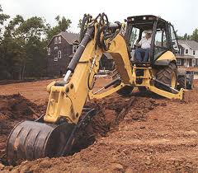
Safety Talk 19
Trenching - Protection
Never enter a trench more than 4 feet
deep unless it’s:
Sloped
Shored
Protected by a trench box

Slide 55
Safety Talk 19
Trenching - Protection
Sloping
  Sloped or benched to within 1.2 metres from bottom
  and not exceeding 1 metre vertical rise for each metre of horizontal run
  In solid rock that’s not stable, rock bolts, wire mesh or shoring must be used

Slide 56
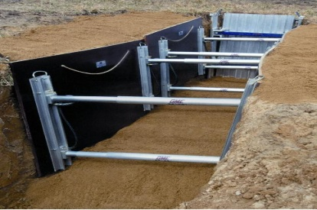
Safety Talk 19
Trenching - Protection
Shoring
Supports walls to prevent soil movement
  Can be timber or hydraulic
    Consist of wales, struts and sheathing
Hydraulic shoring can be installed from the top
Shoring should be done as excavation proceeds

Slide 57
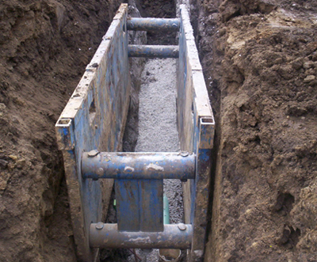
Safety Talk 19
Trenching - Protection
Trench boxes
Meant to protect workers
Should be back filled to prevent movement
Commonly used away from utilities, roadways and foundations
Workers should stay inside the box

Slide 58
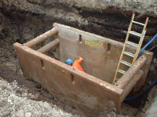
Safety Talk 19
Trenching - Protection
Ladders
Trenches must be provided with ladders
Must be tied off at the top
Must extend 1 metre or 3 feet above trench
Should never be more than 30 metres or 50 feet away

Slide 59
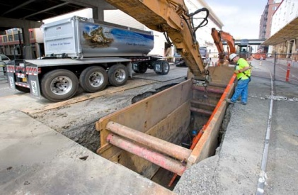
Safety Talk 20
Trenching - Inspection
Around Trenches
Check ground for tension cracks around shoring
Check for water seepage (undermines trench walls) around trench boxes
Check for movement

Slide 60
Safety Talk 20
Trenching - Inspection
With hydraulic shoring look for:
Leaks in hoses and cylinders
Bent bases
Broken or cracked nipples
Cracked, split or broken sheathing

Slide 61
Safety Talk 20
Trenching - Inspection
With timber shoring check for:
Cracked or bowed sheathing
Wales crushed where they join struts
Loose or missing cleats
Split or bowed wales
Struts off-level

Slide 62
Safety Talk 20
Trenching - Inspection
In trench boxes look for:
Deformed plates
Bent or distorted welds in sleeves and struts
Missing struts
Bent struts
Holes, bends or other damage to plates

Slide 63
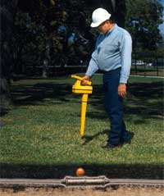
Safety Talk 25
Underground Utility Locates
Call the utility owner before digging
Contractor must ask utility to locate and mark underground services
Uncovering underground services must be done by hand
Once actual location is determined excavating equipment can be used

Slide 64
Safety Talk 25
Underground Utility Locates
Utility provider must be present if fibre optics is being uncovered
Pipes, conduits and cable must be supported
Breaks can also threaten public
CALL BEFORE YOU DIG

Slide 65
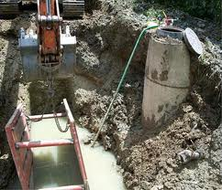
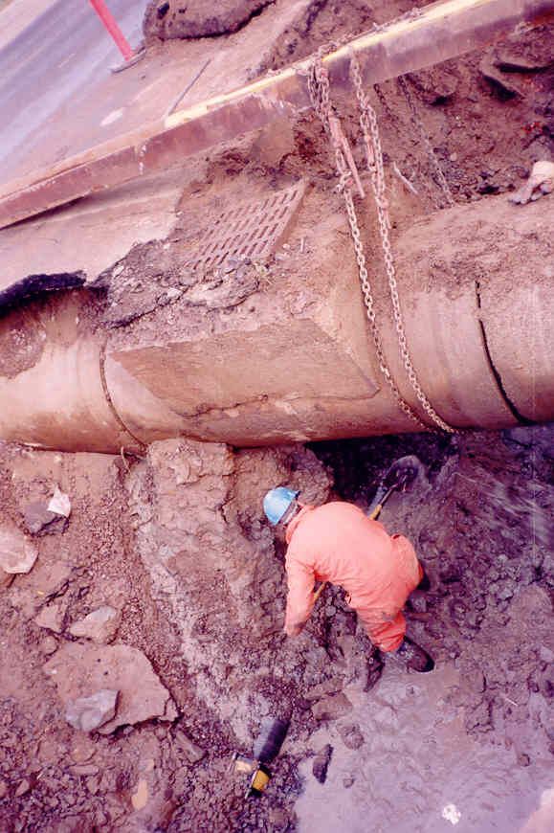
Safety Talk 25
Underground Utility Locates
Beam and chain supporting pipe

Slide 66
Hazard Alert
New Brunswick Worker Buried Alive
Trench was 1.8 metres deep by 2 metres wide
Made up of topsoil, gray silt and imported soil
3 cave-ins; work continued
4th cave-in buried worker to his shoulders
5th cave-in completely reburied victim and buried owner to his shoulders

Slide 67
Hazard Alert
New Brunswick Worker Buried Alive
Never enter a trench unless it is sloped, braced or caged
If there’s a cave-in,
  GET OUT AND STAY OUT until the trench has been made safe

Slide 68

Trenching – Zero Tolerance
Lives are at risk and the law is clear
Safe trenching procedures will save lives
There are no shortcuts to safety

Slide 69
Trenching – Zero Tolerance
No shortcuts - No exceptions - No second
chance
Zero tolerance means:
  Stop work orders
  Restricting use of equipment
  Fines
  Imprisonment

Slide 70
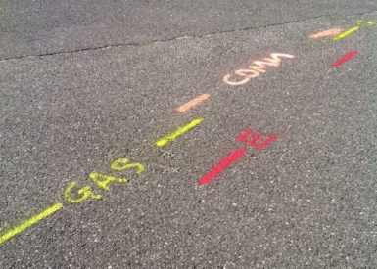
Summary
Regulation Overview
Section 180
Locate underground utilities
Within 600 mm of utilities:
  Authority has been notified
  Utility has been de-energized
  Adequate procedure is used
Secure posts within 3 m of trench 1.2 metre deep

Slide 71
Summary
Regulation Overview
Section 181
Do not enter trench unless:
It is less than 1.2 m deep
It is shored, braced or caged
Sloped or benched
Caging certified by engineer if mobile equipment is used

Slide 72
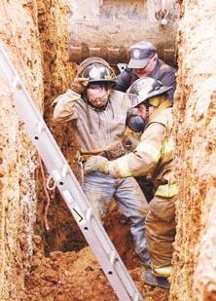
Summary
Regulation Overview
Section 182
Do not enter trench unless:
Loose materials that may fall have been removed
Ladder extends 1 m and is no further than 15 metres
Install shoring from distance greater than trench

Slide 73
Summary
Regulation Overview
Section 183
Employer shall ensure:
Excavated material is kept at least 1.2 m away
In solid rock more than 1.8 m:
Excavated material is kept back at least distance of its height
Or adequate fencing is used

Slide 74
Summary
Regulation Overview
Section 184
Employer shall ensure:
Excavation is kept reasonably free of water
If hazardous gases or oxygen deficient atmosphere may exist, testing is carried out
Precautions to prevent accumulation of gases and adequate ventilation is provided

Slide 75
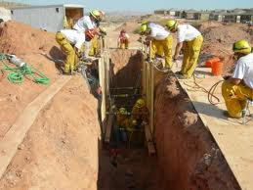
Summary
Regulation overview
Section 185
Employer shall ensure:
Employee on the surface is able to observe employee working in trench

Slide 76
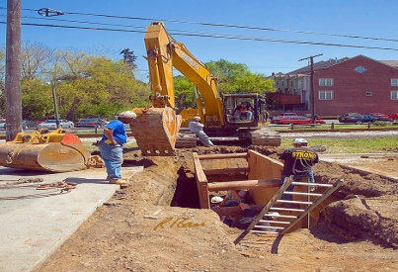
Summary
Regulation Overview
Section 186
Employer shall ensure:
That operator of mobile equipment doesn’t lower material into trench unless:
  They have an unrestricted view, or
  A signaller is used

Slide 77
Summary
Regulation Overview
Section 187
An employee shall not move or stay under any
material being lowered into trench

Slide 78
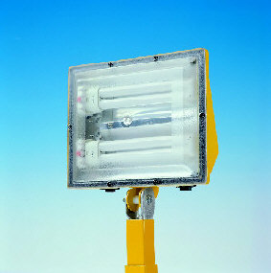
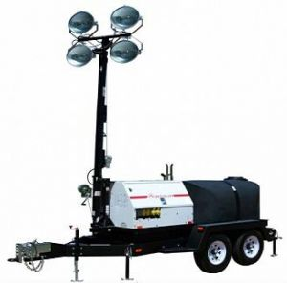
Summary
Regulation Overview
Section 188
Employer shall ensure:
That trench is adequately illuminated
That adequate barrier is used to protect employees from vehicular traffic

Slide 79

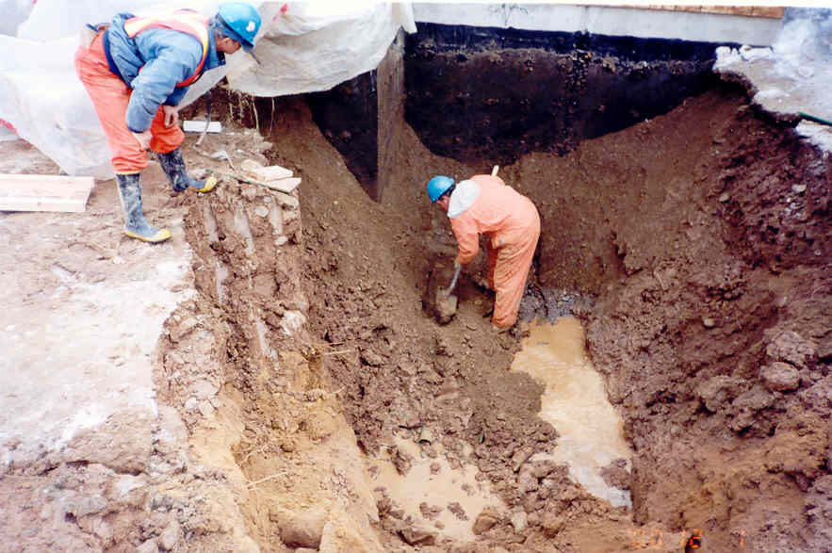
Summary
Questions and Discussion
Point to ponder… Is soil stable?

Slide 80
Summary
Questions and Discussion
Points to ponder…
Shoring, bracing or caging
Sloping or benching
Keeping clear of water
Access and egress
Traffic safety

Slide 81
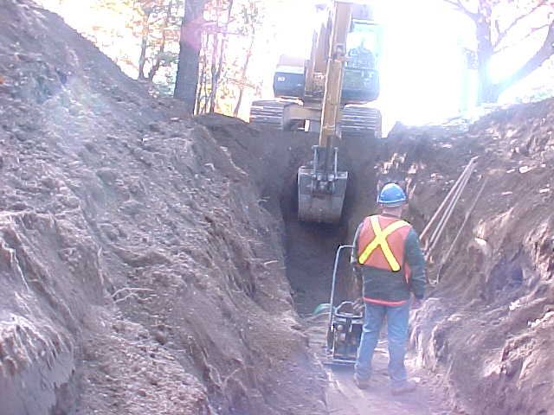
Summary
Questions and Discussion
Point to ponder…Ensure driver has good field of vision

Slide 82
Summary
Questions and Discussion
Points to ponder…
Loose material that may fall in has been removed
Shoring adequate to support mobile equipment
Employee may be exposed to engine fumes
Access and egress

Slide 83
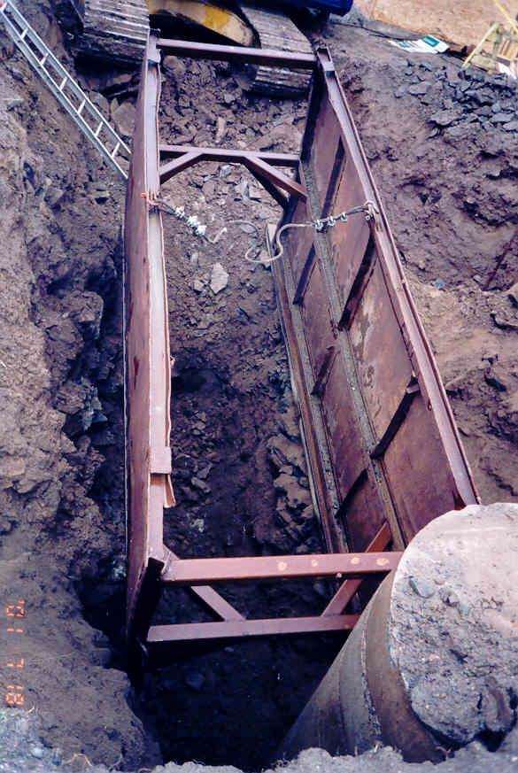
Summary
Questions and Discussion
Point to ponder… Would you trust your life on this box?

Slide 84
Summary
Questions and Discussion
Points to ponder…
Ladder outside of trench box
Trench box not back-filled
  Permits easier access and egress and prevents shifting

Slide 85
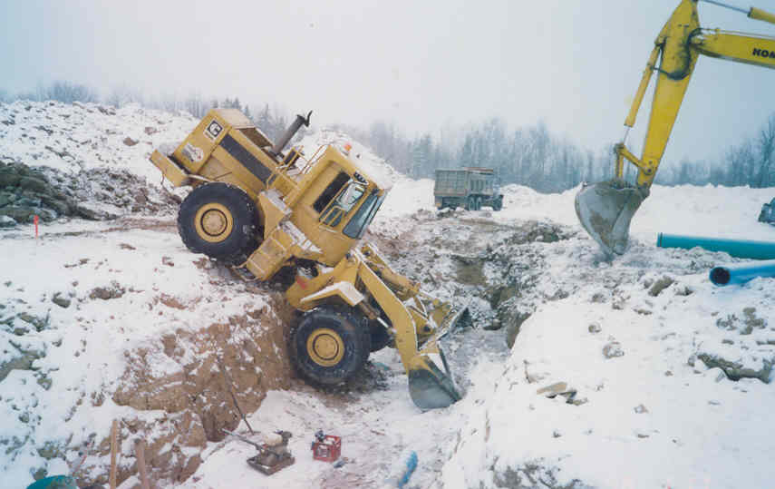
Summary
Questions and Discussion
Point to ponder… Vehicles can become a danger!

Slide 86
Summary
Questions and Discussion
Points to ponder…
Employer shall
  provide…instruction, training and supervision
Barrier to protect from vehicular traffic

Slide 87
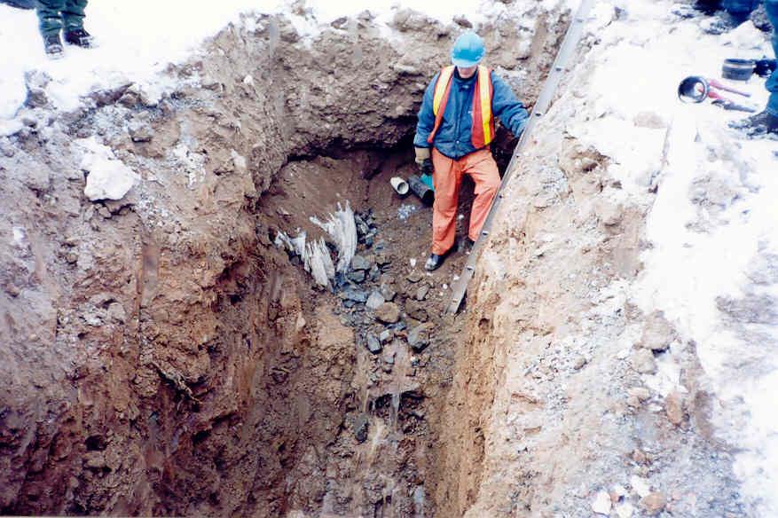
Excavations and Trenches
Due Diligence
What are YOU doing?

Slide 88
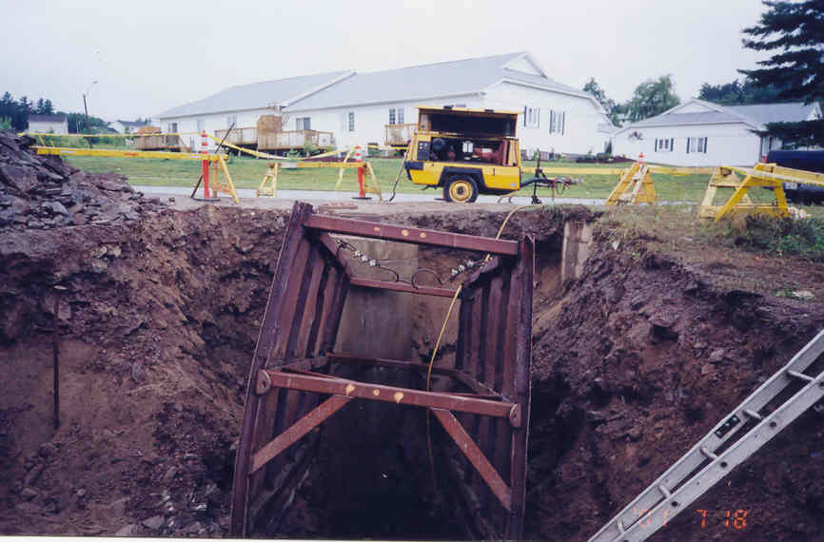
Excavations and Trenches
Due Diligence
Is it adequate? How many infractions can you identify?

Slide 89
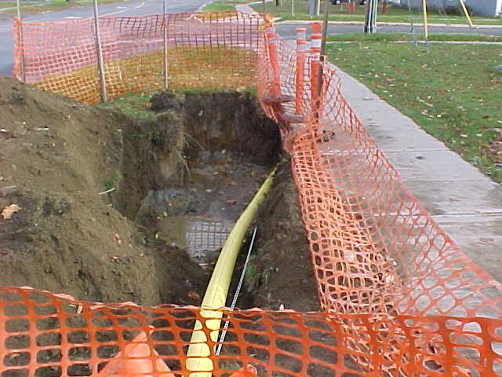
Excavations and Trenches
Due Diligence
Your Excavations
and
Trenches -
Are they safe?

